Slide 1
Information Technology Essentials
Technology
Applications of Technology
Malone, Thomas. 15.561 Information Technology Essentials, Spring 2005. (MIT OpenCourseWare: Massachusetts Institute of Technology), http://ocw.mit.edu/courses/sloan-school-of-management/15-561-information-technology-essentials-spring-2005 (Accessed 19 Nov, 2014). License: Creative Commons BY-NC-SA

Slide 2

Why bother?
Why should you, as a manager, care about information technology?
Notes:
This is the only time the class will go at this nice pace.

Slide 3
Main Course Objectives
Become comfortable with the technologies that are shaping business today
Acquire tolls that will help you assess technological trends long after you have left Sloan

Slide 4
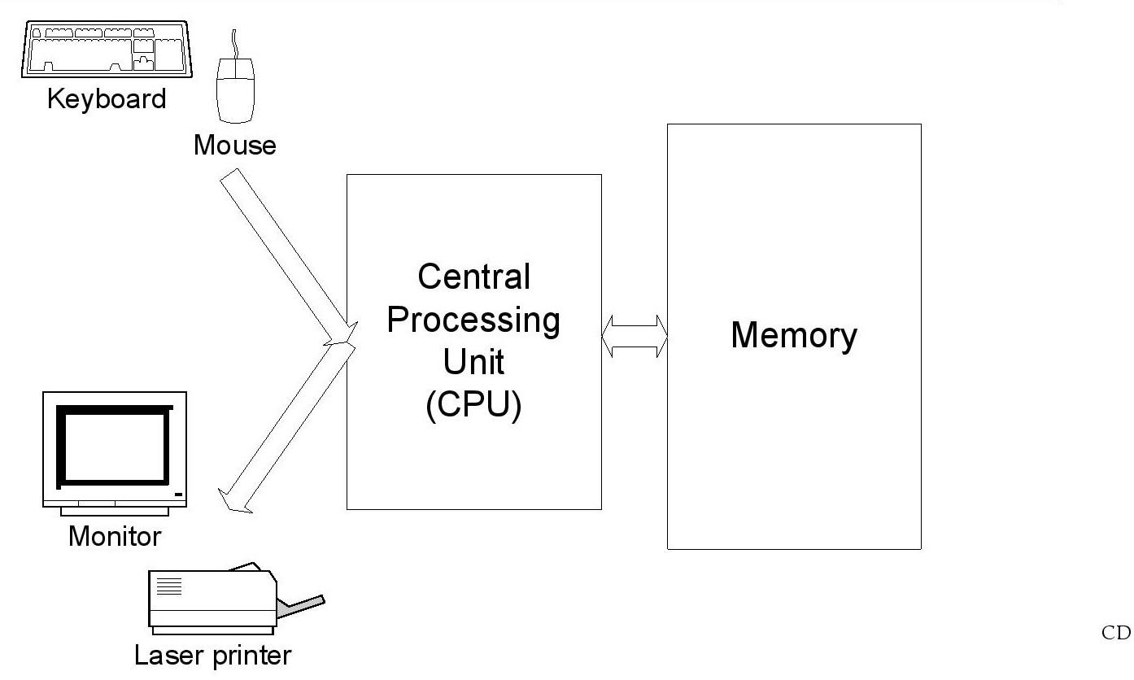
A Typical Computer

Slide 5
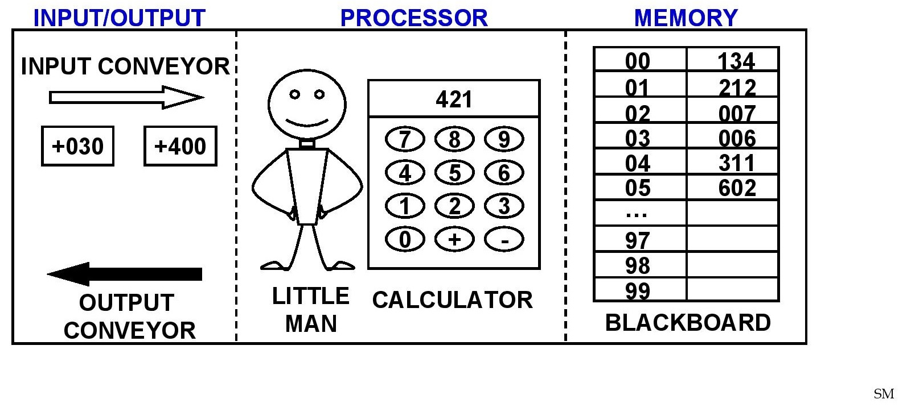
A Simplified Computer

Slide 6
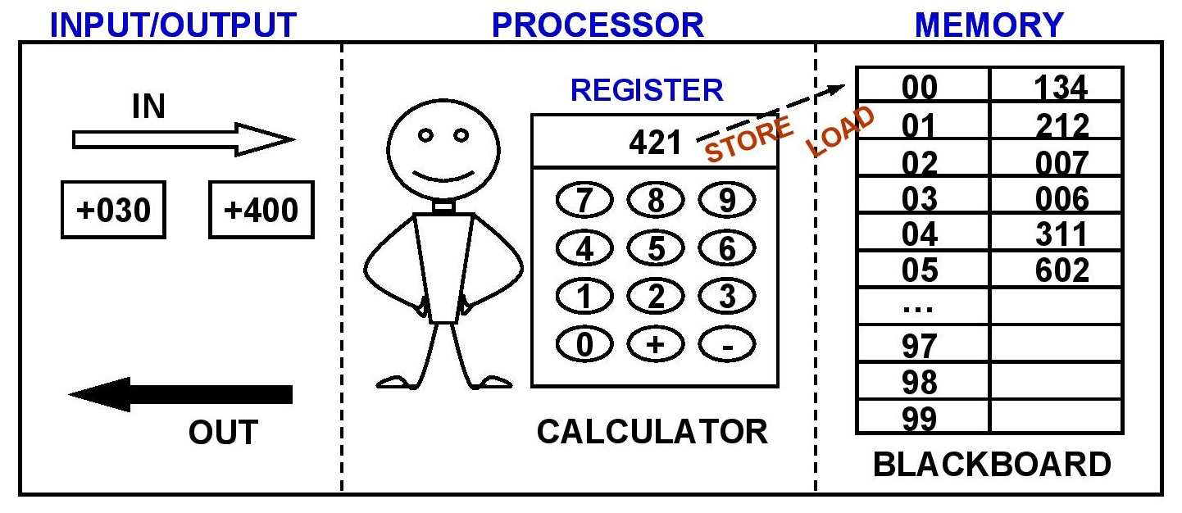
A Simplified Computer
Memory
There are 100 “locations” on the blackboard
Each location has room for one 3-digit number
Load moves number from blackboard to register. Example: LOAD 01
Store moves number from register to blackboard. Example: Store 00

Slide 7
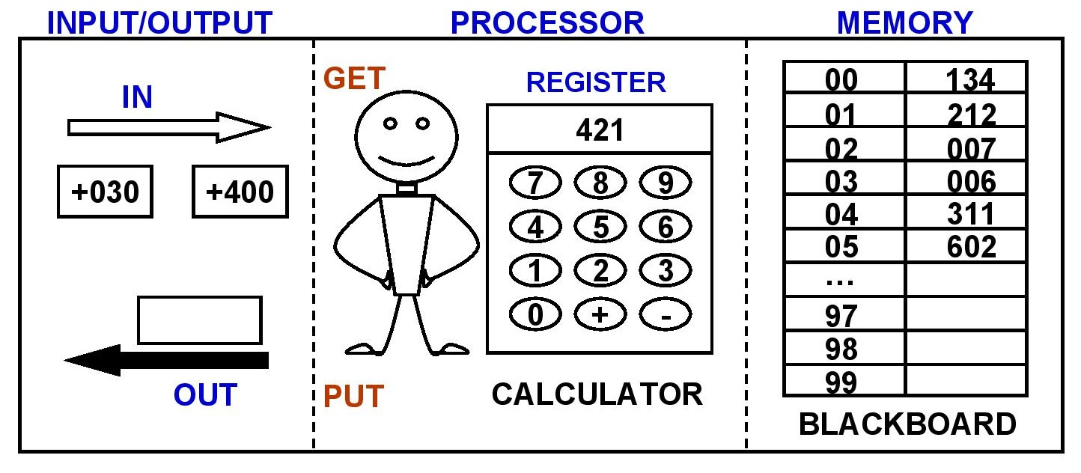
A Simplified Computer
Input/Output
Input and Output conveyors hold 3-digit numbers.
GET moves number from input to register.
Put moves number from register to output

Slide 8
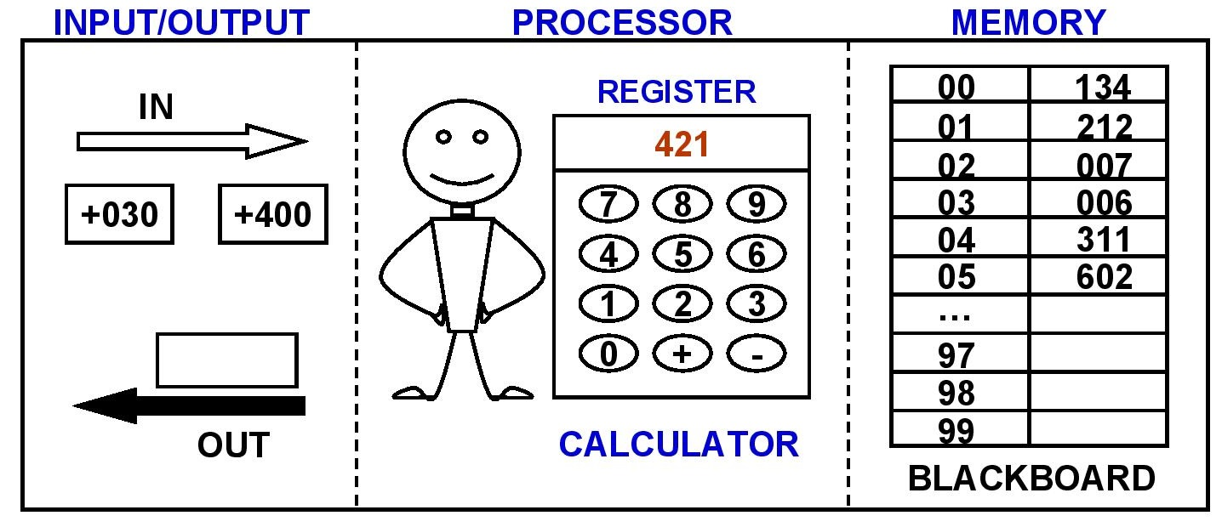
A Simplified Computer
Processor/Calculator
Register has room for one 3-digit number.
Calculator can add and subtract numbers from memory to register.
Example: ADD 02
SUBTRACT 03

Slide 9
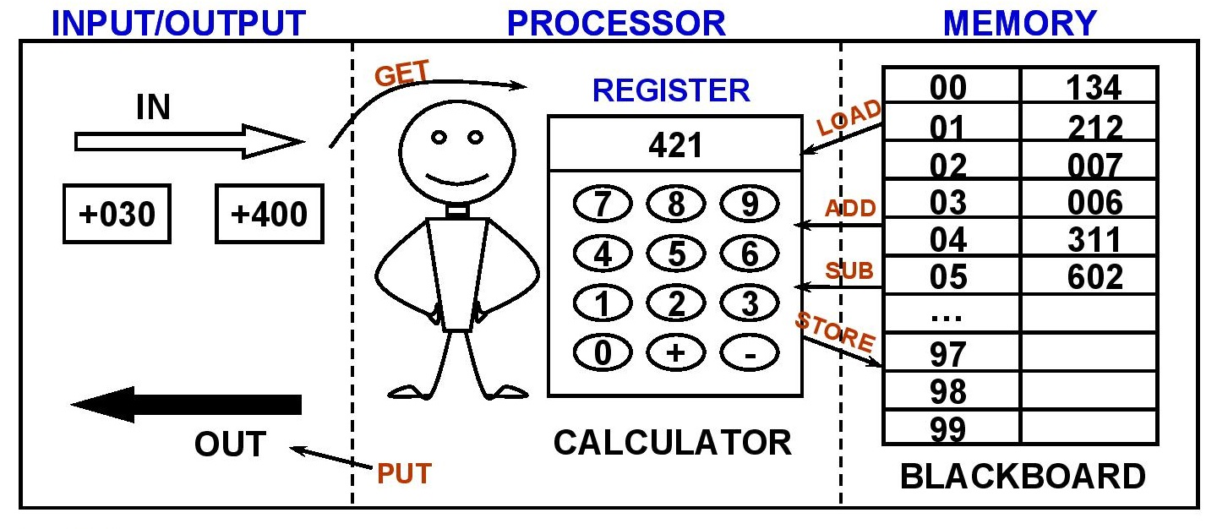
LMC INSTRUCTIONS
Get
Put
Load x (Load 01)
Store x (Store 05)
Add x (Add 02)
Sub x (Sub 03)
Stop

Slide 10
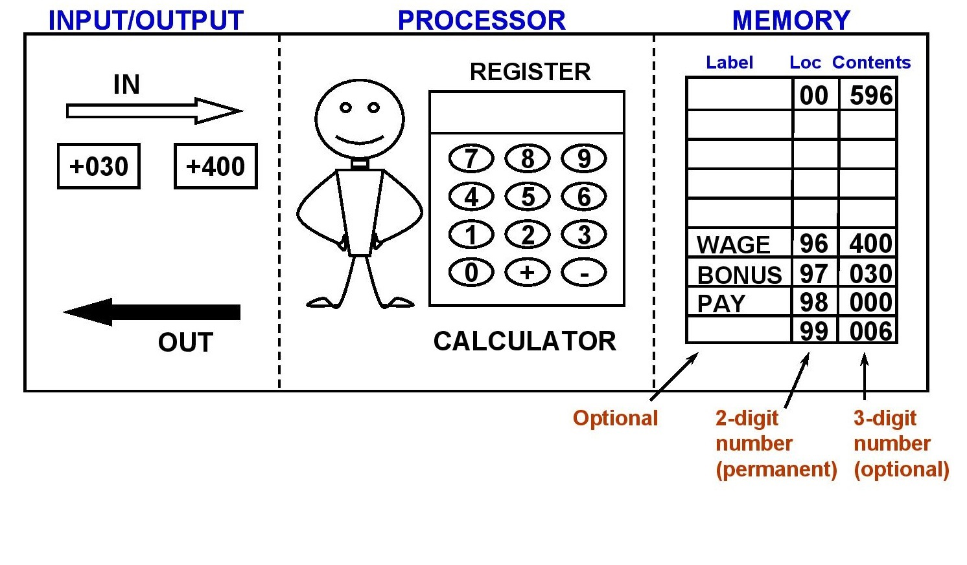
SYMBOLIC LMC INSTRUCTIONS
Example Instruction Sequence
Calculate Pay = Wage + Bonus
Load Wage
Add Bonus
Store Pay
Stop

Slide 11
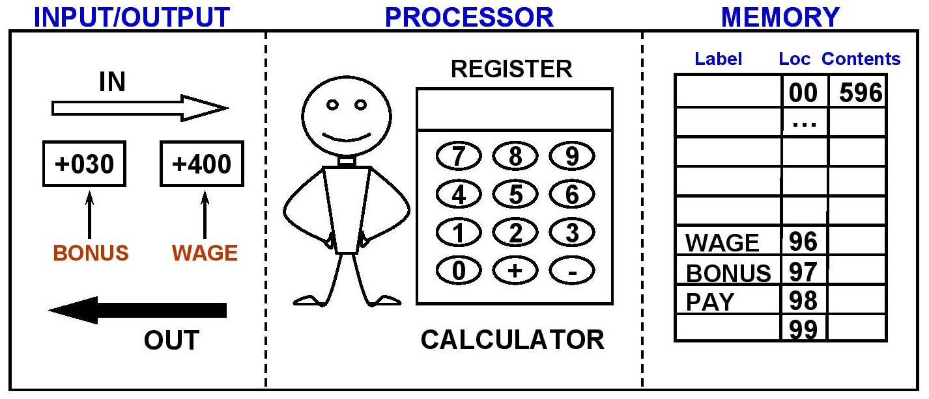
Program to:
Read WAGE and BONUS amount from INPUT
Compute total PAY
Output total PAY
STEP INSTRUCTION STEP INSTRUCTION
1. 5.
2. 6.
3. 7.
4. 8.

Slide 12
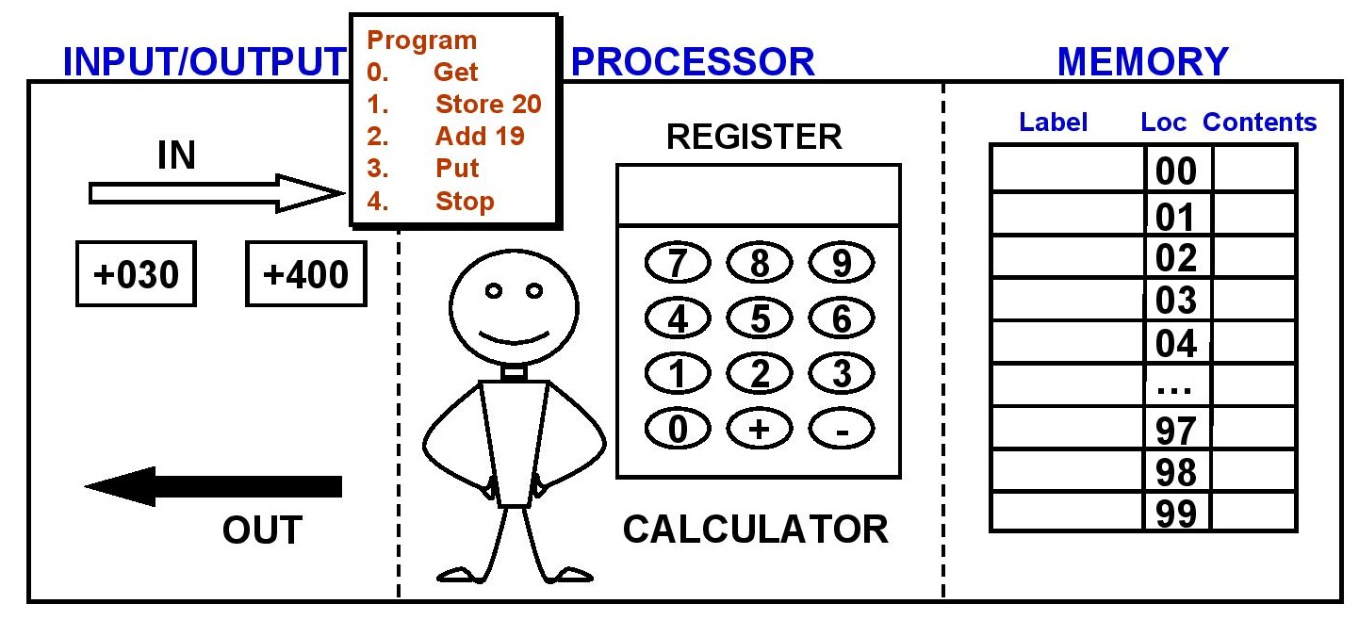
LMC STORED PROGRAM CONCEPTS
ISSUES:
Where is LMC program stored?
How does LMC understand instructions like STOP? It only likes numbers.
How does LMC handle symbolic labels like A, B, C
ANSWERS (Stored Program Concept):

Slide 13
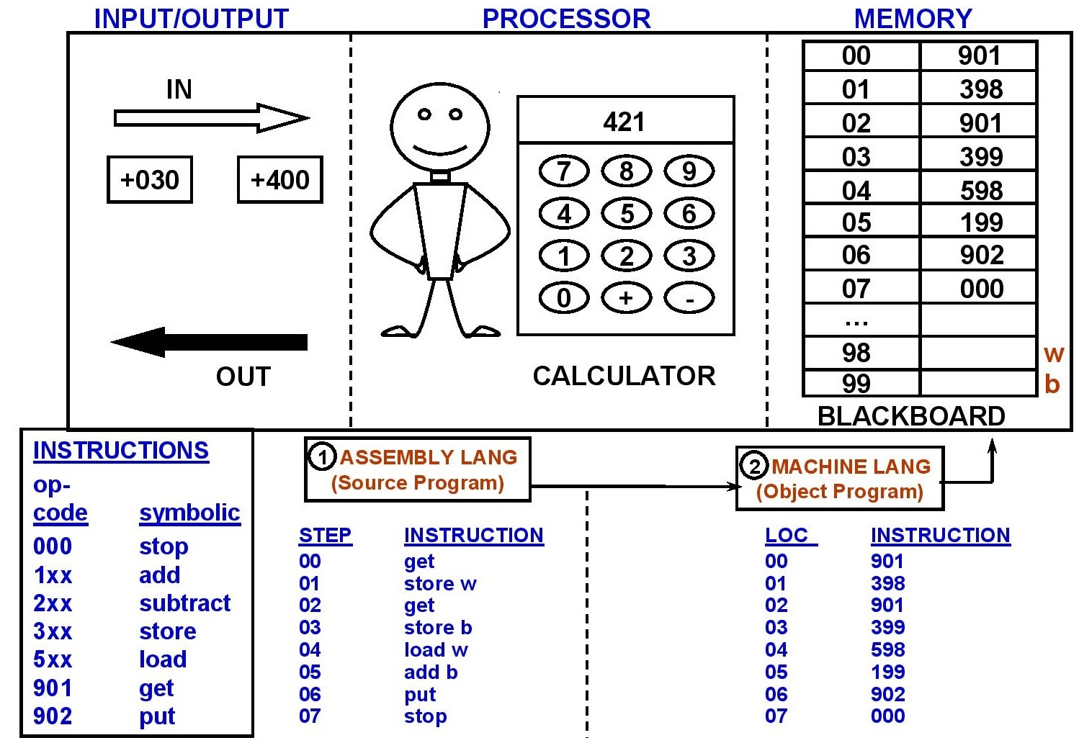
LMC MACHINGE LANGUAGE AND ASSEMBLY LANGUAGE

Slide 14
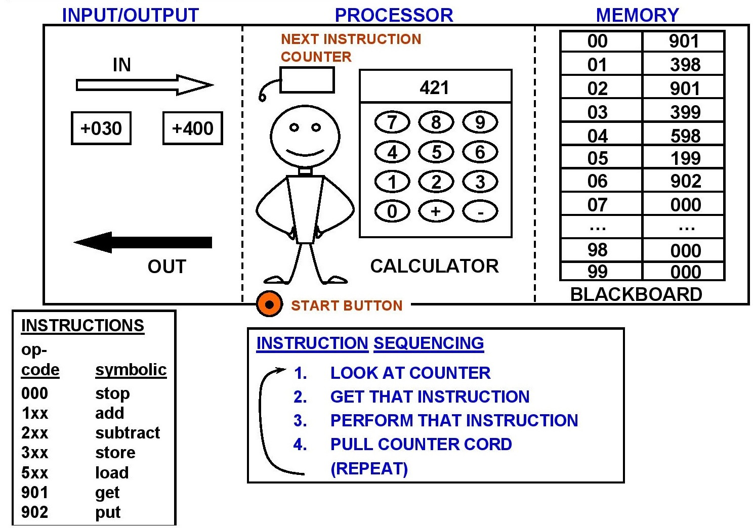
INSTRUCTION SEQUENCE

Slide 15
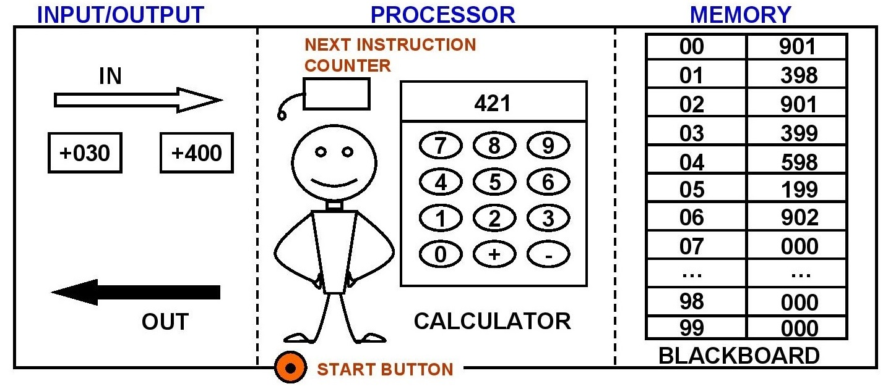
INSTRUCTION SEQUENCE
Control Flow
BRANCH always puts a new address in the instruction counter.
BRANCH ZERO puts a new address in the instruction counter if the REGISTER is 0. Otherwise it increases the instruction counter by 1.
Examples: BRANCH 02
BRANCH ZERO 06

Slide 16
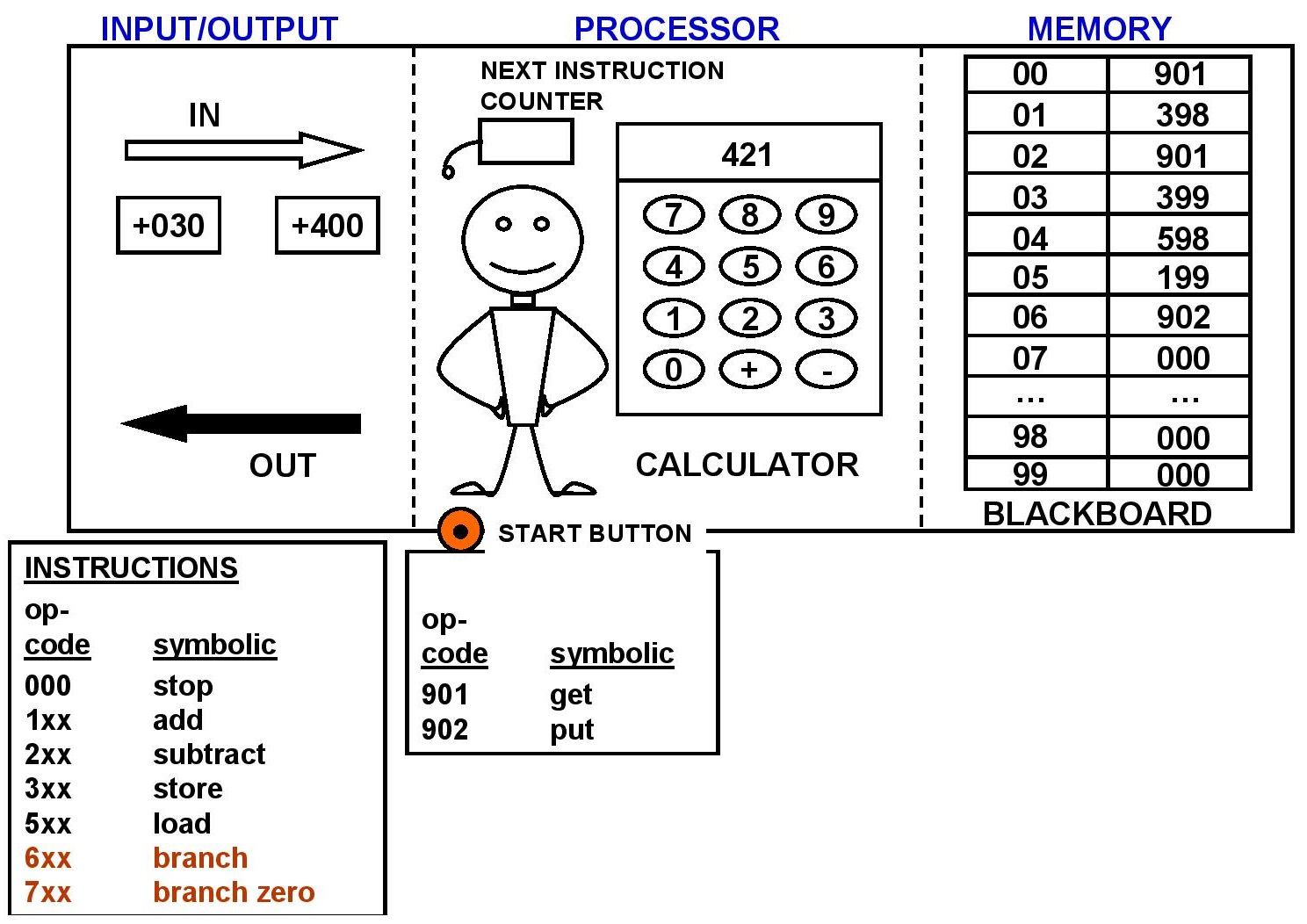
INSTRUCTION SEQUENCE
So what are:
MIPS and MHz all about?

Slide 17
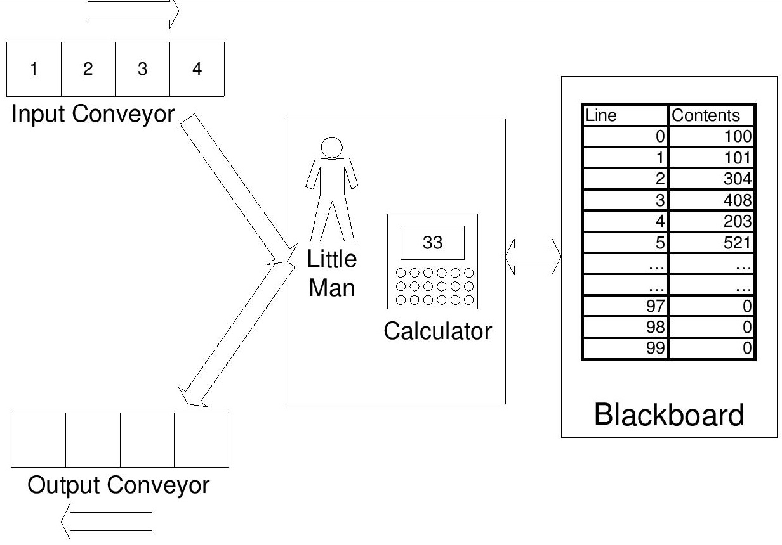
The Little Man Computer

Slide 18
BASIC FACTS TO ASK ABOUT ANY COMPUTER
MEMORY
BASIC UNIT 3 DECIMAL DIGIT NUMBER
MAXIMUM SIZE 100 LOCATIONS
REGISTERS
HOW MANY 1
NUMBERS 3 DECIMAL DIGIT NUMBER
INSTRUCTIONS
NUMBER 7 INSTRUCTIONS

Slide 19
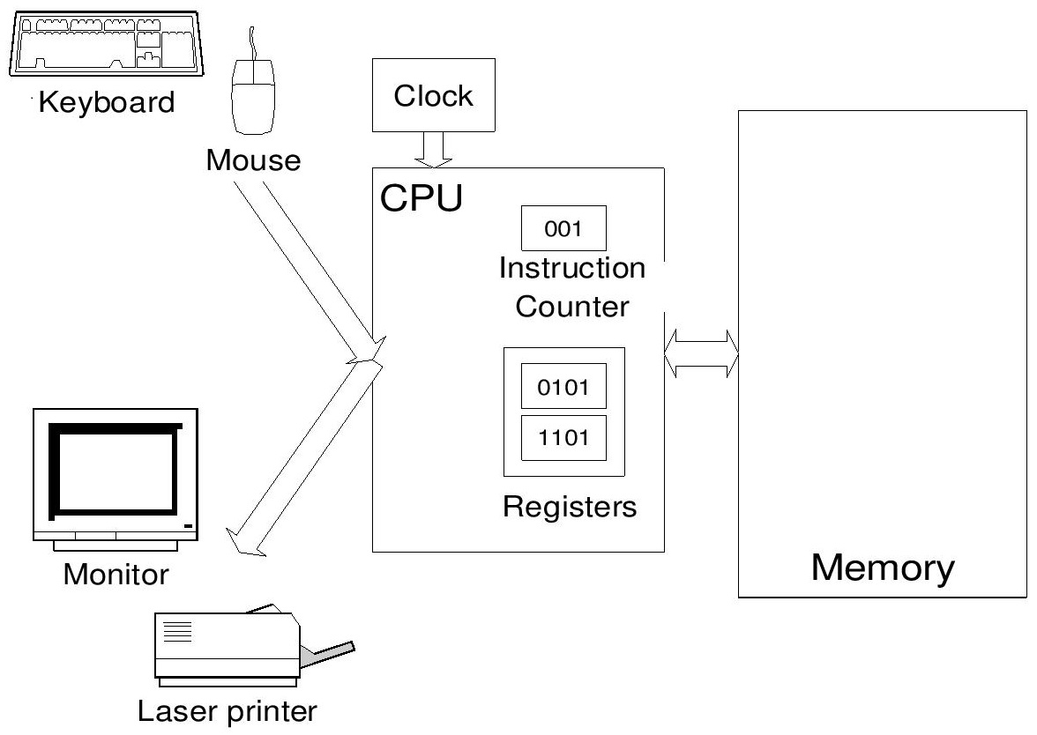
The ‘Real’ Computer

Slide 20
INTEL PENTIUM 4 ANSWERS
MEMORY
BASIC UNIT 8 BINATY DIGITS (BITS) = 1 BYTE
MAXIMUM SIZE 32 BITS = 4 BYTES
TYPICAL SIZE MEMORY RAM: 128 MB – 1GB
REGISTERS
HOW MANY ABOUT 50 REGISTERS
NUMBERS BARIOUS TYPES
INSTRUCTIONS
NUMBER ABOUT 500
8 BITS
0 0 1 0 1 1 0 1

Slide 21
Binary Computers
Real computers don’t store and calculate with 3-digit decimal numbers
A bit (binary digit) distinguishes between tow states
TRUE and FALSE
1 and 0
Bits are easier to implement in machines
Light bulbs on or off
High vs. low voltages (on wires)
Magnetized or not (computer hard disks, floppies, tapes)
Pit or no pit detected by a laser (compact discs)

Slide 22
Interpretation of a decimal number
3 7 9
3x100 + 7x10 + 9x1
3x10² + 7x10¹ + 9x10⁰

Slide 23
Interpretation of a decimal number
1 1 0 1 1
1x2⁴ + 1x2³ + 0x2² + 1x2¹ + 1x2⁰
1x16 + 1x8 + 0x4 + 1x2 + 1x12
127

Slide 24
The CPU
CPU = Central Processing Unit
Internal clock ticks very fast (e.g. 1.6GHz = 1.6 billion ticks per second)
Activities are synchronized to start on a clock tick
Some activities take more than one clock tick
Instruction execution is automatic
(tick) find memory address of nest instruction
(tick) retrieve instruction from memory
(tick) decode the instruction
(tick) fetch argument from memory if necessary
(tick) execution instruction
(tick) store result in memory if necessary

Slide 25
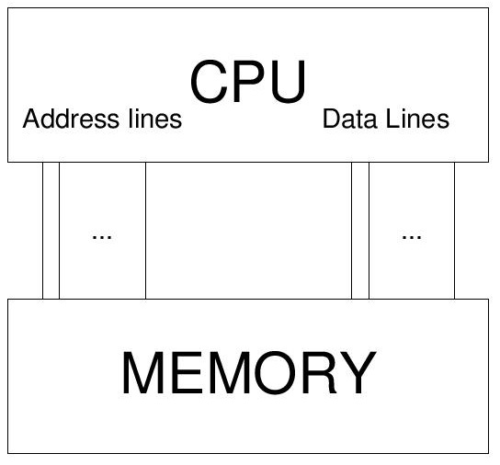
CPU and Memory Interaction

Slide 26
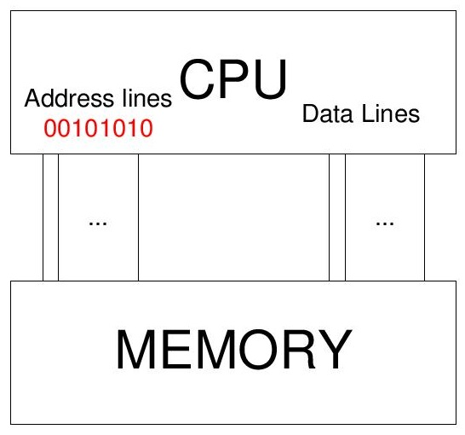
CPU and Memory Interaction
CPU: I need the contents of memory location 50!

Slide 27
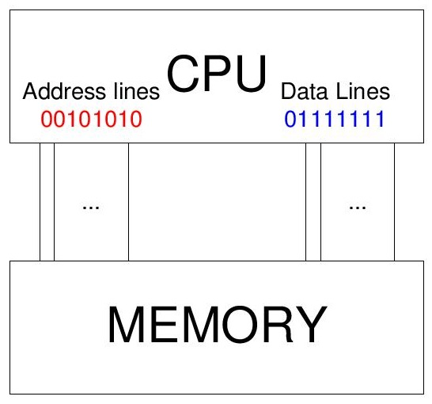
CPU and Memory Interaction
Memory: Location 50 contains the number 127

Slide 28
CPU Characteristics
Family: Determines the set of instructions it understands
Intel 80386, 80486, Pentium, Pentium II, …
Motorola: 68030, 68040
Clock Speed
Pentium: 500 MHz – 2.2 GHz
Data bus width: Size of data that can be manipulated at one time
80486: 32 bits, Pentium: 64 bits
Address bus width: Limits the amount of memory that can be installed in the computer
LMC: 3 decimal digits. Location______
Pentium: 32 bits. Location______
Itanium: 64 bits. Location______

Slide 29
Expressing Memory Capacity
Measured in bytes (=groups of 8 bits)
Each byte can store a binary number from 00000000 to 11111111 (255 = 2⁸-1)
More generally: n binary digits can store numbers from – to 2^{n}-1
Frequently used multiples:
Kilobyte (KB) = 1,024 (2¹⁰) bytes
Megabyte (MB) = 1024 KB = 1,048,576 (2²⁰) bytes
Gigabyte (GB) = 1,024 MB ~ 1 billion (2³⁰) bytes

Slide 30
Semiconductor Memory
RAM (Random Access Memory)
Can access any location equally fast
Loses contents without power
Two main types
Static (SRAM): Faster, expensive
Dynamic (DRAM): Slower, cheaper, consumes less power and space
ROM (Read Only Memory)
Retains memory even without power
Useful to store programs executed upon system start-up (e.g BIOS)

Slide 31
Hard Disks and Floppies
Slower than main memory
Bits stored as magnetic field of different polarity
Magnetized surface of disk rotates under magnetized head (read/write mechanism)
Disk divided into tracks, each at different radius from center
Tracks are divided into sectors

Slide 32
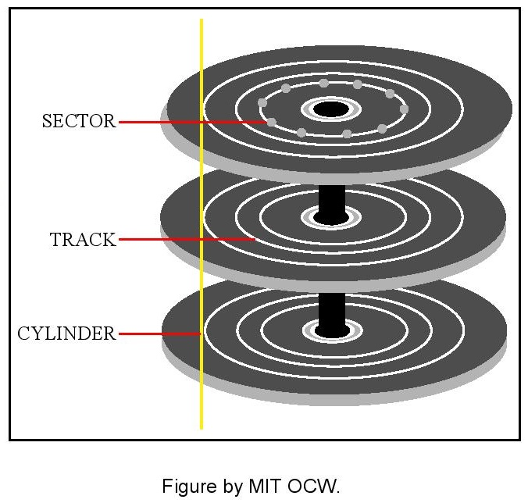
Hard Disk Geometry
Head moves back and forth
To read/write some data:
Head moves over desired track
System waits until desired sector passes under head
Data is read/written

Slide 33
CD-ROMs
Slower than hard disks
Data is encoded by burning miniature “pits” on a photoreflective surface; read by laser
CDs can hold up to 650MB of data
CD-ROM drive maximum transfer speed is expressed in multiples of 150KB/sec
4X drive → 600KB/sec
20X drive → 3000KB/sec

Slide 34
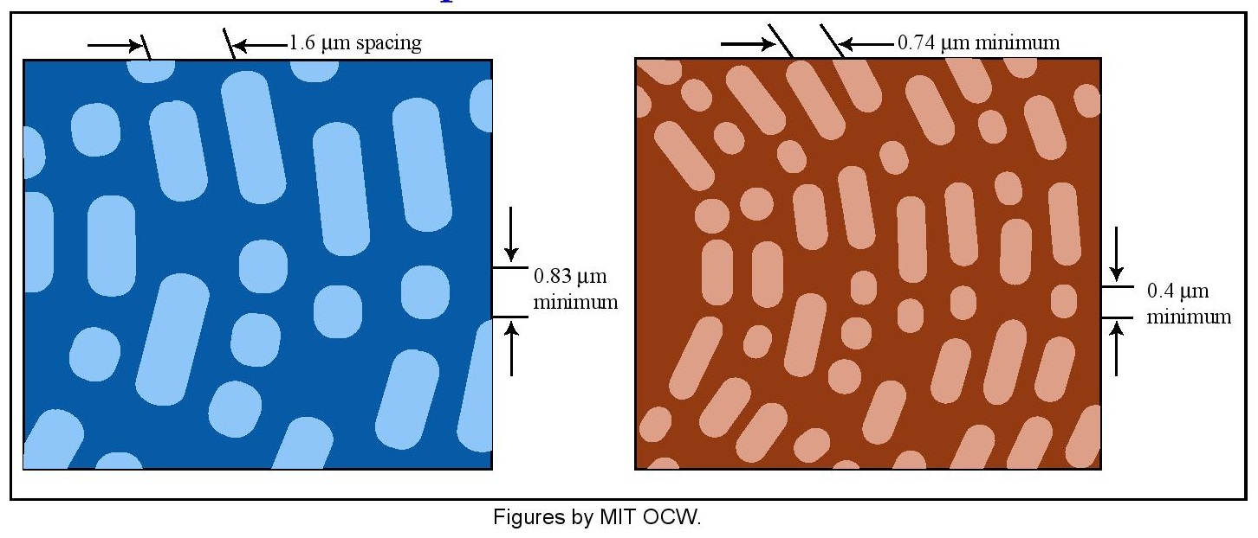
DVD (Digital Video Disk)
New, improved CD-ROM
Smaller, denser, “pits”
Two layers of “pits” recorded on the same disk
DVDs can hold up to 17GB of data

Slide 35
Keychain drives
Hold 16MB – 2GB
Attach to USB (Universal Serial Bus) port
Usually use “flash memory”
A special kind of ROM that can be rapidly erased and re-recorded

Slide 36
I/O Devices
Input
Keyboard
Mouse
Hard Disk
Floppy Disk
…
Output
Printer
Screen
Speakers
…

Slide 37
Computer Displays
Computer screen divided into small dots (pixels)
Each pixel can be displayed in a different color
Screen resolution: Number of pixels per screen
640 x 480
1024 x 768
Color information for each pixel stored in memory, read and converted to video signal 60 times per second
To store information for a 1024 x 768 screen with 256 possible colors for each pixel we need ______ bytes

Slide 38
Buses: Connecting I/O to CPU
One set of wires connect all devices and CPU
Transport of information is shared (public)
Nearly all computers use a bus to connect CPU and I/O Devices
Buses allow easy addition/replacement of I/O Devices
Modern PCs come equipped with expansions slots, directly connected to the bus
I/O Device controllers implemented as expansion cards
Examples: ISA, PCI PCMCIA, IEEE 1394 (FireWire)

Slide 39
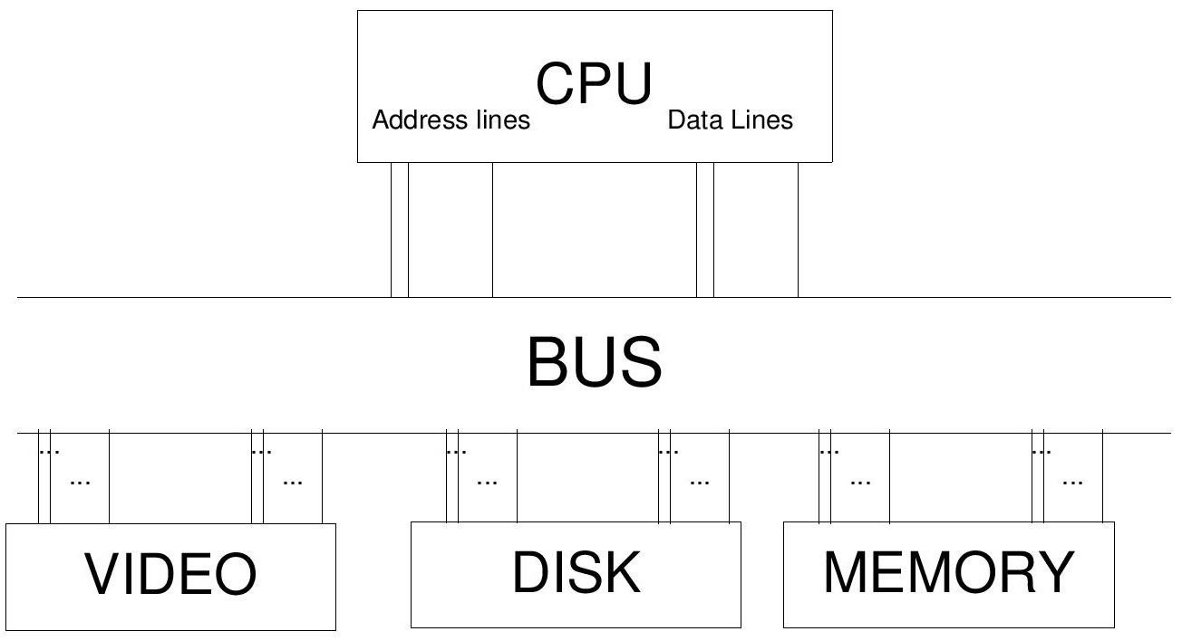
A simple bus architecture

Slide 40
Cache Memory: Motivation
Cheap main memory is slower than CPU
Example: Pentium PCs
CPU 2ns (500MHz)
Main memory (100MHz SDRAM) 10ns
Instructions that access main memory take many more clock ticks than those that don’t
Solution:
Automatically keeps copies of most frequently used memory locations in fast (but expensive) memory = cache memory

Slide 41
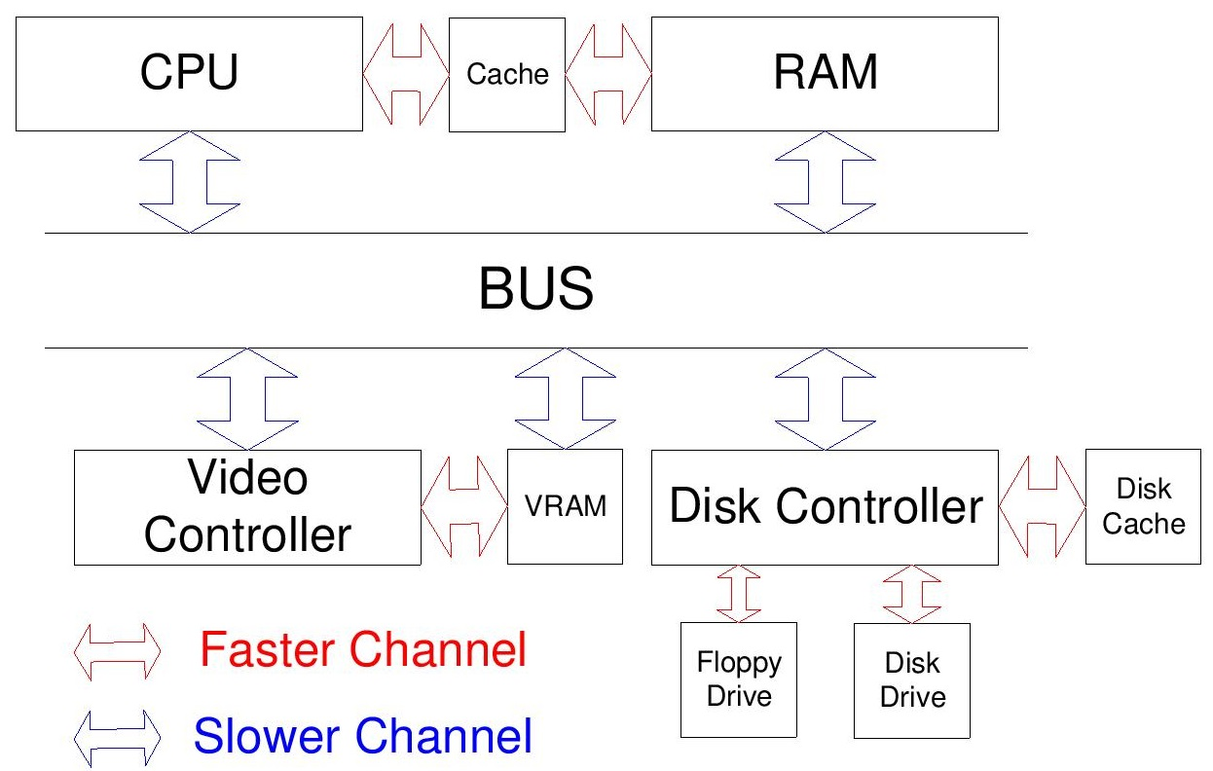
A modern PC architecture (simplified)

Slide 42
Summary: A modern PC
Processor: Pentium (500 MHz - GHz)
Main Memory: 64 MB – 4GB
Floppy Drive: 1.44 MB (3.5-inch disks)
Hard Drive 10 – 500 GB
Graphics: 640 x 480 – 2048 – 1536, 256 to 16 million colors
Video Memory: 32 – 256 MB

Slide 43
Types of software
System Software
Operating systems
Programming languages
Database systems
Application Software
General office tasks (word processing, etc.)
Accounting
Design
Factory automation
…

Slide 44
Operating systems - Examples
DOS
Windows (95, 98, NT, 2000, XP)
Mac OS X
Unix
Linux
…

Slide 45
Operating system
Allocates and assigns:
Memory
e.g. file system, virtual memory
Processor time
e.g. multitasking, multiprocessing
I/O devices
e.g. printer, keyboard, etc.
May also provide other capabilities useful to many users or programs
Graphical User Interface (GUI) capabilities
Fonts, network protocols, …
Web browser?

Slide 46
Illusion #1: Multitasking
Reality:
One CPU
One instruction at a time
Illusion:
Several application programs executing concurrently
Implementation:
Operating system divides CPU time among application programs (time sharing)
Each program “thinks” it is the only one running
OS copies Instruction Pointer and Registers back and forth as each program takes its turn

Slide 47
Multitasking issues
How is control passed to next task?
Cooperative multitasking (Windows, Windows 95)
Application explicitly passes control back to OS
What if application never passes control back?
Preemptive multitasking (Unix, NT, XP)
Can one task access the memory of another one?
Preventing this is called “memory management”
Done by Unix, NT, XP< Mac OS X (Not by older versions of Mac OS and Windows)

Slide 48
Illusion #2: Virtual Memory
Some data is not used for a long time
Why keep it all in memory?
Copy a unit of data (called a “page”) to hard disk and use memory for other data
Copy pages back from hard disk to main memory as they’re needed
Process (and its programmer) not aware that main memory is too small (the big memory illusion)
It asks for a main memory location (Page #, offset on page)
OS has to get that page into main memory if not already there

Slide 49
Illusion #3: File Systems
Reality:
Disks are set of tracks
Tracks are sets of sectors
Sectors can store fixed-sized byte blocks
Illusion:
Disks are sets of directories
Directories contain other directories or files
Files are variable-size byte sequences
Directories and files have names

Slide 50
Illusion #4: Windows and Menus
Reality: Screen is an array of pixels
Illusion 1: Menus
Depending on where you click, different action happens
Technique: OS look up location where mouse was clicked, executes appropriate action
Illusion 2: Overlapping windows
A window may cover part of all of another
When a window is uncovered, its contents are redisplayed
Technique: OS saves bitmap of covered windows
Application does not need to know how to redraw the contents of its window

Slide 51
Microcomputer Operating Systems
DOS
Text-based interface, no multitasking
Windows
Windows, cooperative multitasking
Filenames restricted to 8 characters
Bad memory management!
Windows 98
Large filenames
Built-in networking capabilities
Plug-and-play device configuration

Slide 52
Microcomputer Operating Systems
Windows NT (including Windows 2000, Windows XP)
Full multitasking
Full memory management
UNIX (including Linux)
Great memory management, multitasking
Complex, text-based interface
Mac OS X
Based on Unix
Easy to use
Can only run on Macintoshes

Slide 53
Selecting an Operating System
Is our existing software compatible with the OS?
Does the OS have a large base of compatible software?
How reliable is the OS? Does it crash frequently?
Is the OS available for a wide variety of hardware?
How quickly does it run?
How easy it is to learn and use?
How easy is it to install and configure?
How much does it cost?

